Slide 1
Blue House to Haddricks Mill
www.spaceforgosforth.com www.facebook.com/groups/space.gosforth/ www.twitter.com/space4gosforth

Slide 2
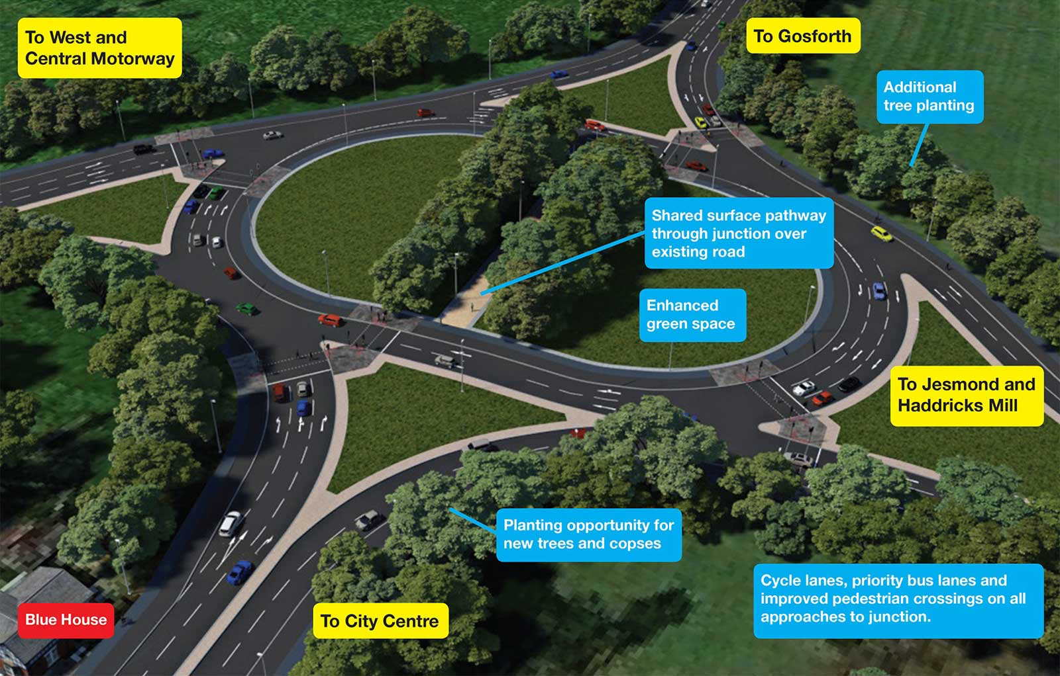
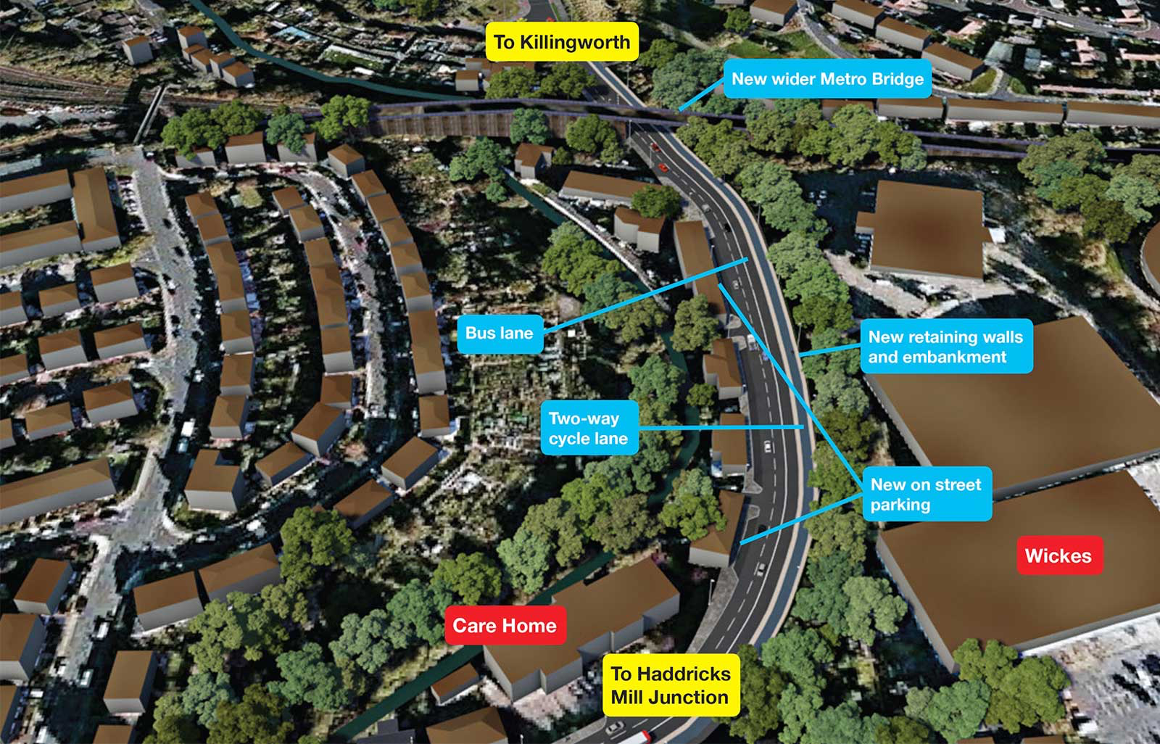
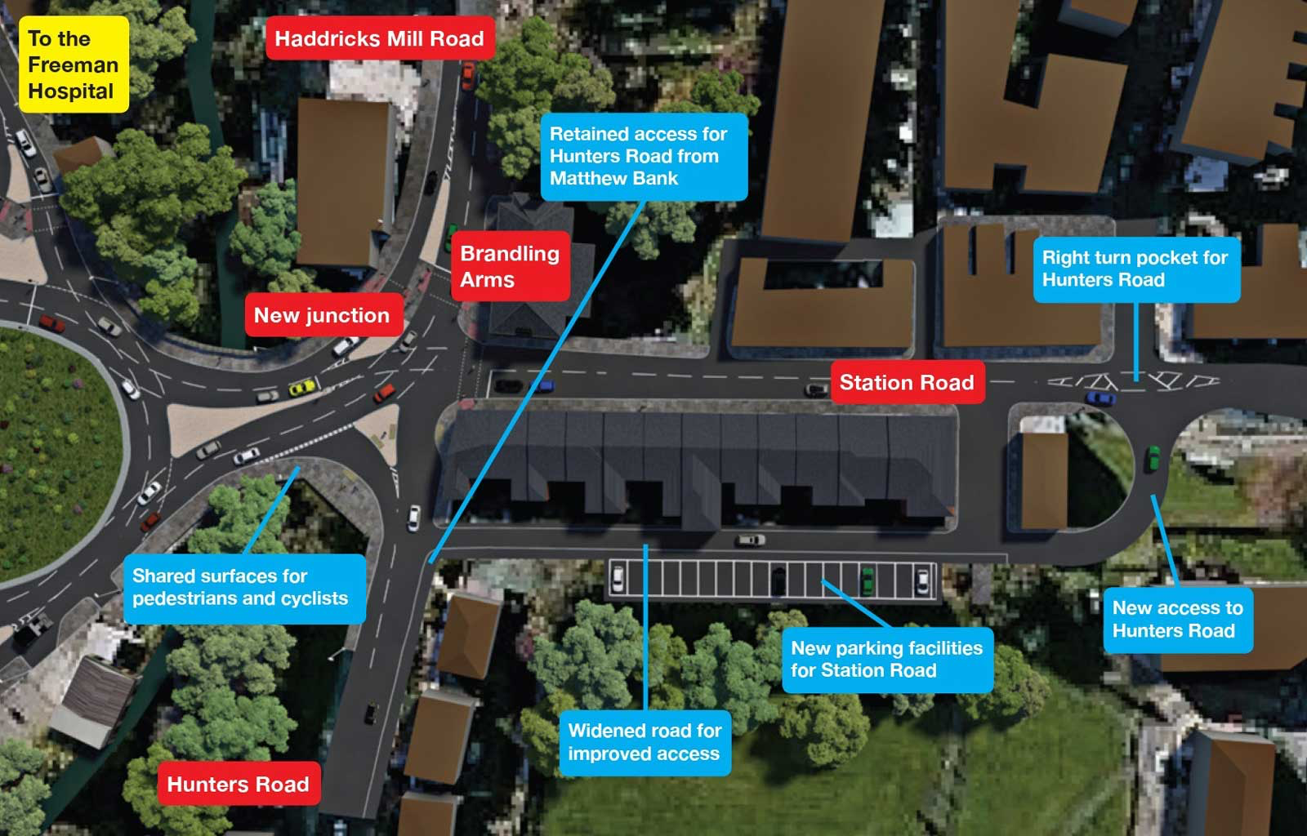
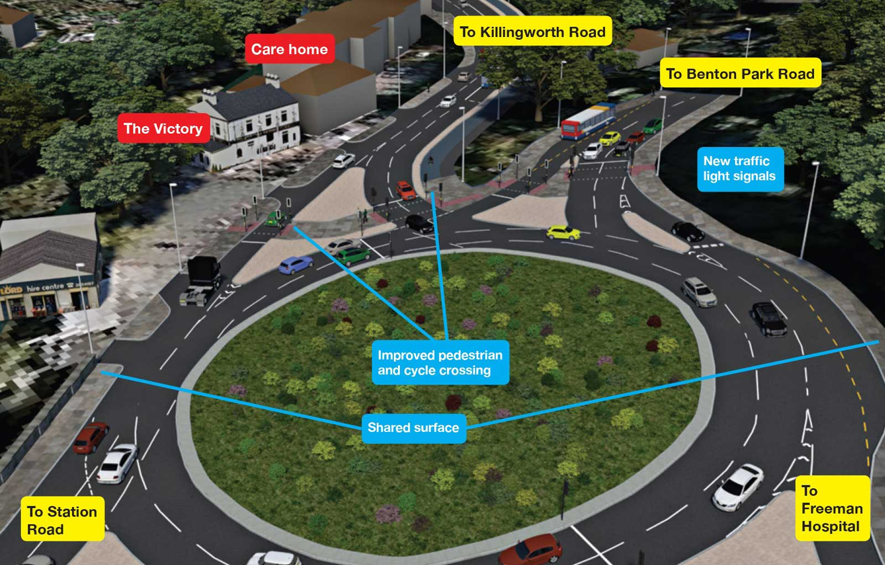
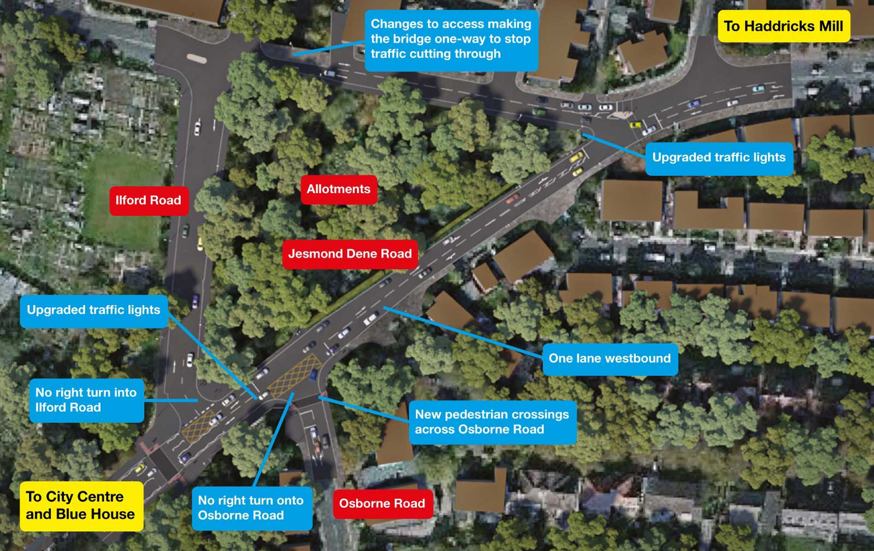

Slide 3
REQUIREMENT 1
What are streets for?
Six Roles for Streets by
Transport for London
Newcastle’s
Newcastle
http://content.tfl.gov.uk/streetscape-guidance.pdf
Movement Place
www.spaceforgosforth.com www.facebook.com/groups/space.gosforth/ www.twitter.com/space4gosforth

Slide 4
Two Extremes?
SOLUTIONS?
Movement Place
www.spaceforgosforth.com www.facebook.com/groups/space.gosforth/ www.twitter.com/space4gosforth

Slide 5
REQUIREMENT 2
2014 Vehicle Traffic Volumes
Average weekday http://gis2.gateshead.gov.uk/GatesheadMaps/ctf/
28,320
16,643
82,152
8,482
14,794
Haddricks Mill
19,222
18,676
7,209
Blue House
32,471
13,834
48,966
50,191
The Council is forecasting ~20-25% growth in vehicle traffic
www.spaceforgosforth.com www.facebook.com/groups/space.gosforth/ www.twitter.com/space4gosforth

Slide 6
What the Council says…
“The scale of the junction required to meet likely growth to and beyond 2030 therefore reflects a scenario that could change depending on the interest and likelihood of people changing their mode of travel or altering the time of trips.
“If, for example, there was a significant change in how young people who are currently passengers in cars accessed their schools, or in how people who currently drive to or from work passing along or across this route travelled, then significantly less space would be required to accommodate such trips in the future.”
From the Newcastle City Council’s Frequently Asked Questions Document p10
https://www.newcastle.gov.uk/sites/default/files/wwwfileroot/planning-and-buildings/transportation-developments/faqs.pdf
www.spaceforgosforth.com www.facebook.com/groups/space.gosforth/ www.twitter.com/space4gosforth

Slide 7
Tonight, with you, we want to
Improve the proposals so they:
Help people* to get about: to school; to work; to the shops; to see friends…
Maximise people-moving capacity to avoid the need for more urban motorways or building on the Town Moor
Improve air quality
Improve safety for everyone
Connect & protect neighbourhoods
www.spaceforgosforth.com www.facebook.com/groups/space.gosforth/ www.twitter.com/space4gosforth

Slide 8
The “Northern Access Corridor”
Haddricks Mill
You are here
AQMA
AQMA
Schools/
Employment
Sites
Traffic-free paths
Blue House
✔

Slide 9
Proposed Changes
- Locations
Salters’ Lane
Metro Bridge
Haddricks Mill
Station Road
Haddricks Mill
Junction
You are here
Matthew Bank /
Haddricks Mill Road
High West
Jesmond
Changes needed but none proposed
Jesmond Dene Road / Osborne Road
Blue House
Blue House Junction
✔

Slide 10
Themes from the Commonplace feedback:
Newcastle’s future should not be urban motorways and over-sized junctions – other cities have done this already, found it didn’t work and are now reallocating that space back for people.
Air Pollution: Building vehicle capacity induces traffic – congestion benefits will be short-lived but air pollution will linger.
Slow, indirect routes and shared space will discourage walking and cycling, and key safety objectives will not be achieved.
Roads should not be barriers that limit mobility. Crossing is important too.
The Town Moor must be protected. It is a key part of the Newcastle upon Tyne ‘brand’, gives Newcastle a distinctive character and enhances the city’s status.
www.spaceforgosforth.com www.facebook.com/groups/space.gosforth/ www.twitter.com/space4gosforth

Slide 11
Haddricks Mill:
Salters’ Lane
Metro Bridge
www.spaceforgosforth.com www.facebook.com/groups/space.gosforth/ www.twitter.com/space4gosforth

Slide 12
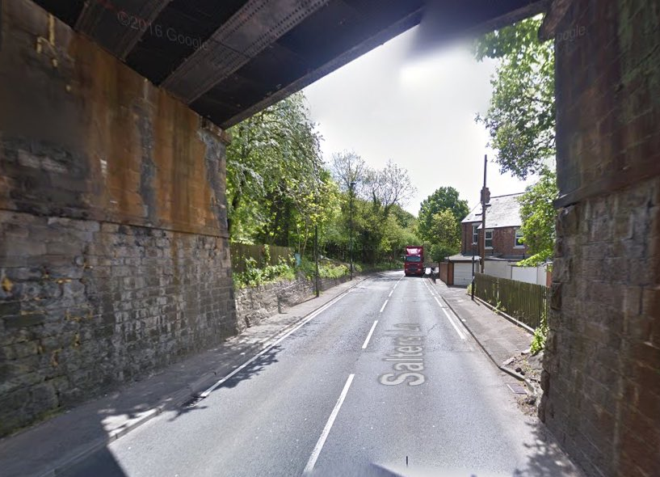
www.spaceforgosforth.com www.facebook.com/groups/space.gosforth/ www.twitter.com/space4gosforth

Slide 13
Haddricks Mill
Junction
www.spaceforgosforth.com www.facebook.com/groups/space.gosforth/ www.twitter.com/space4gosforth

Slide 14
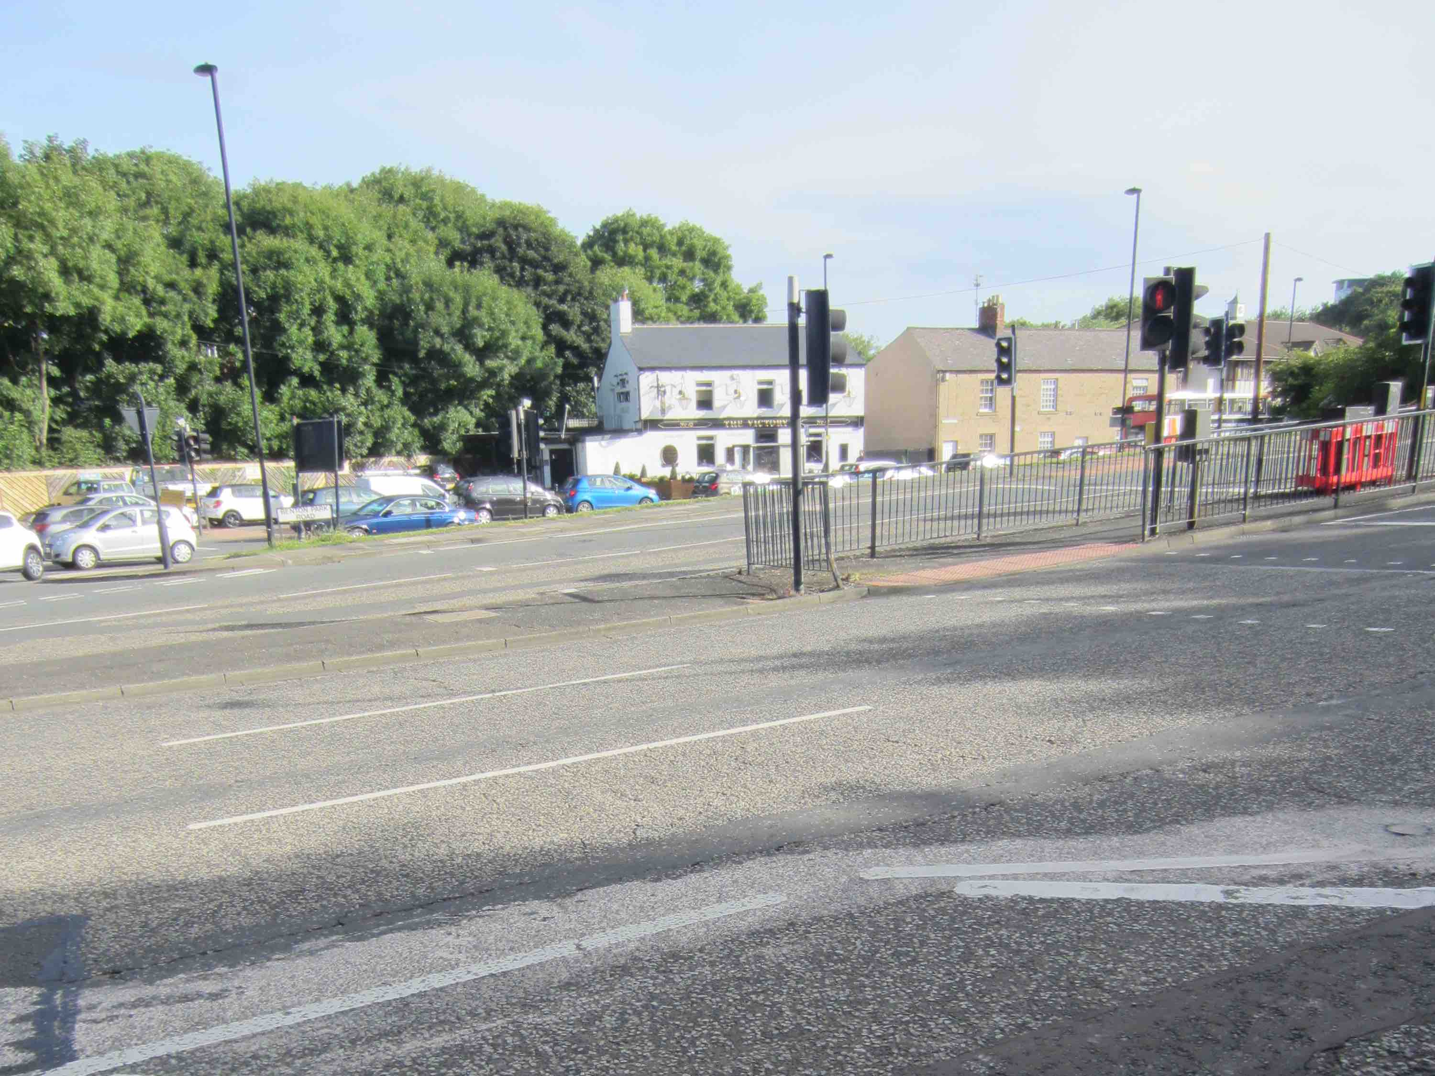
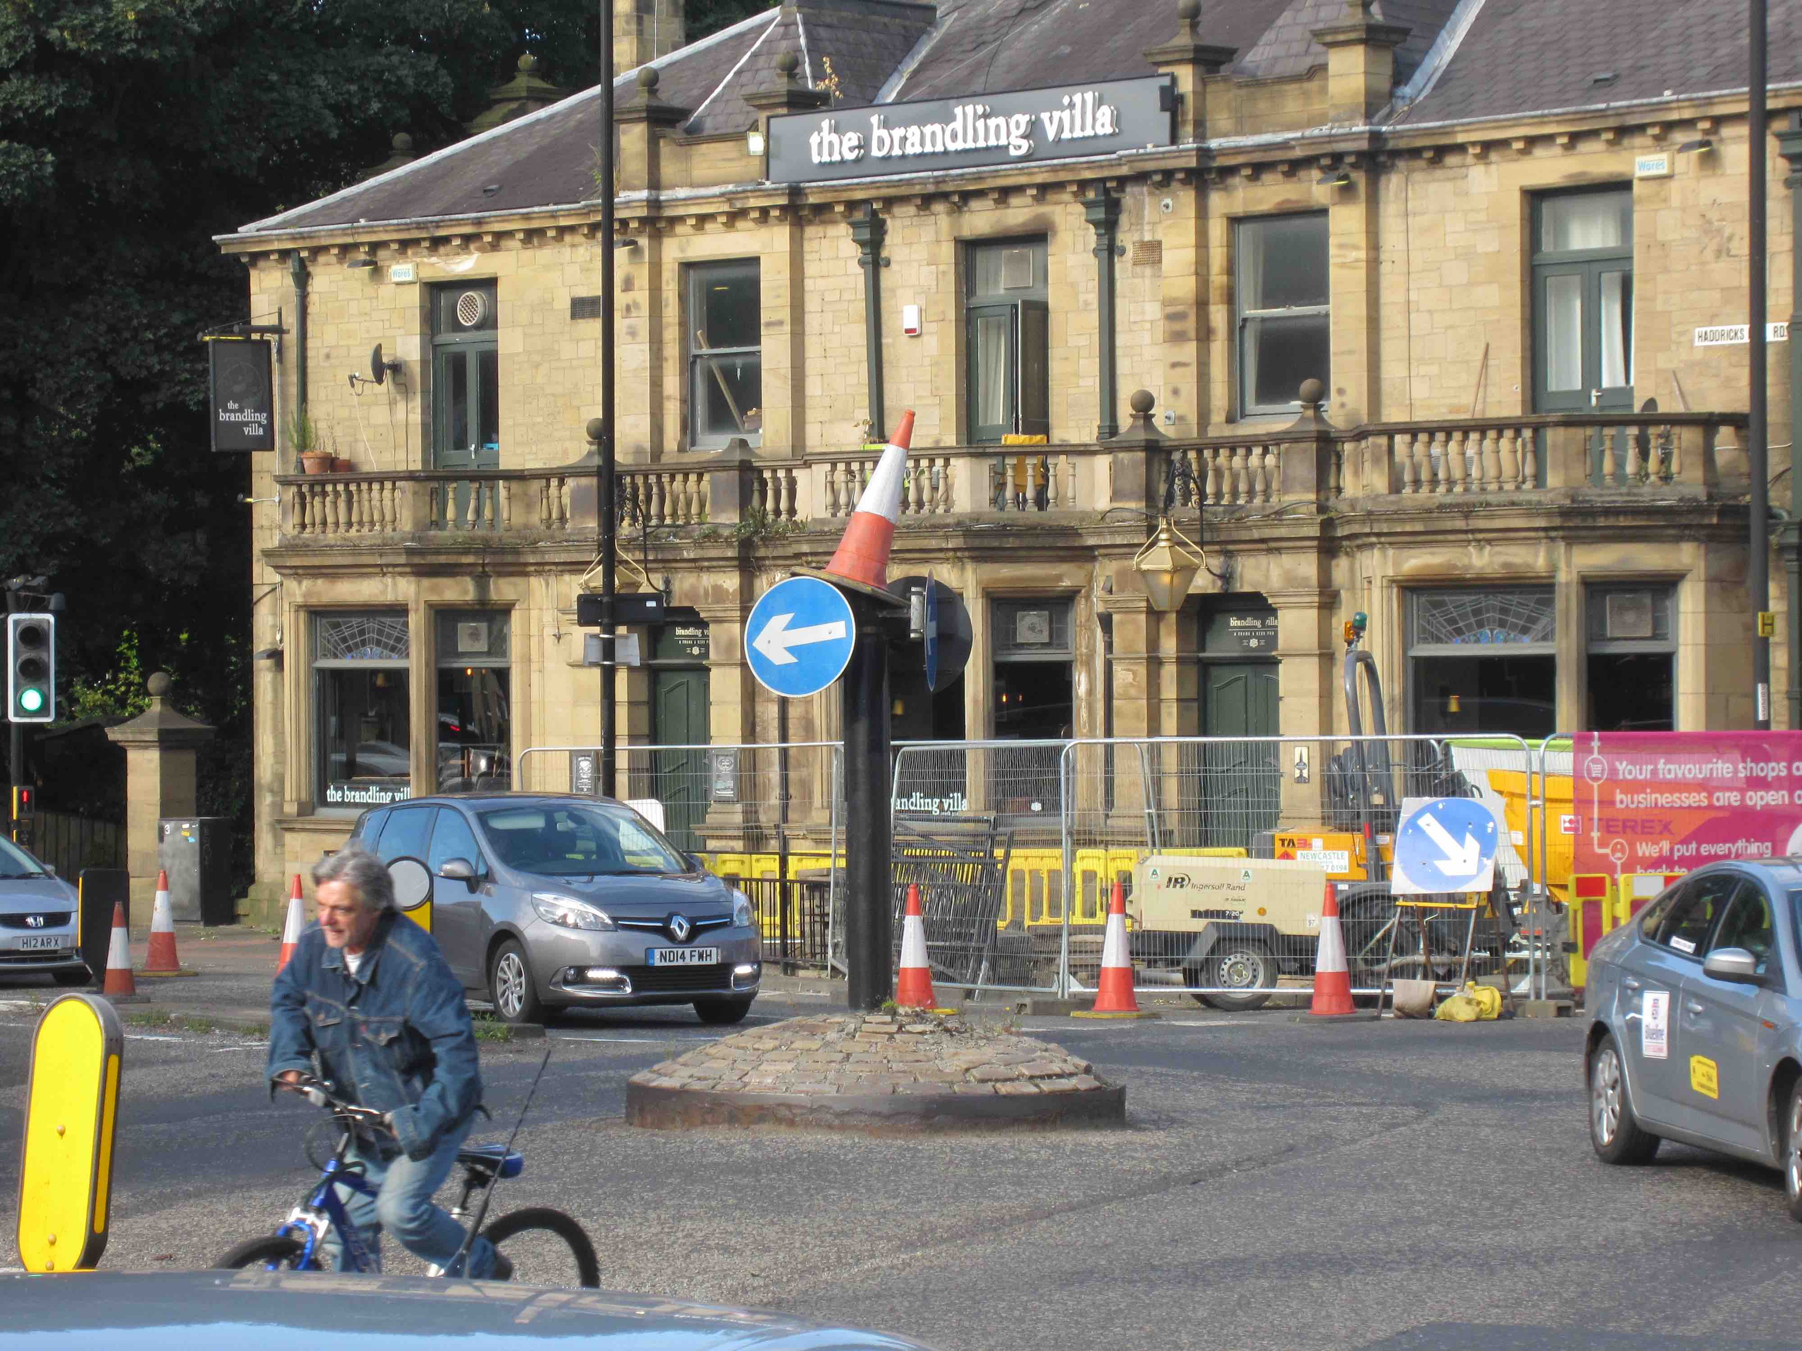
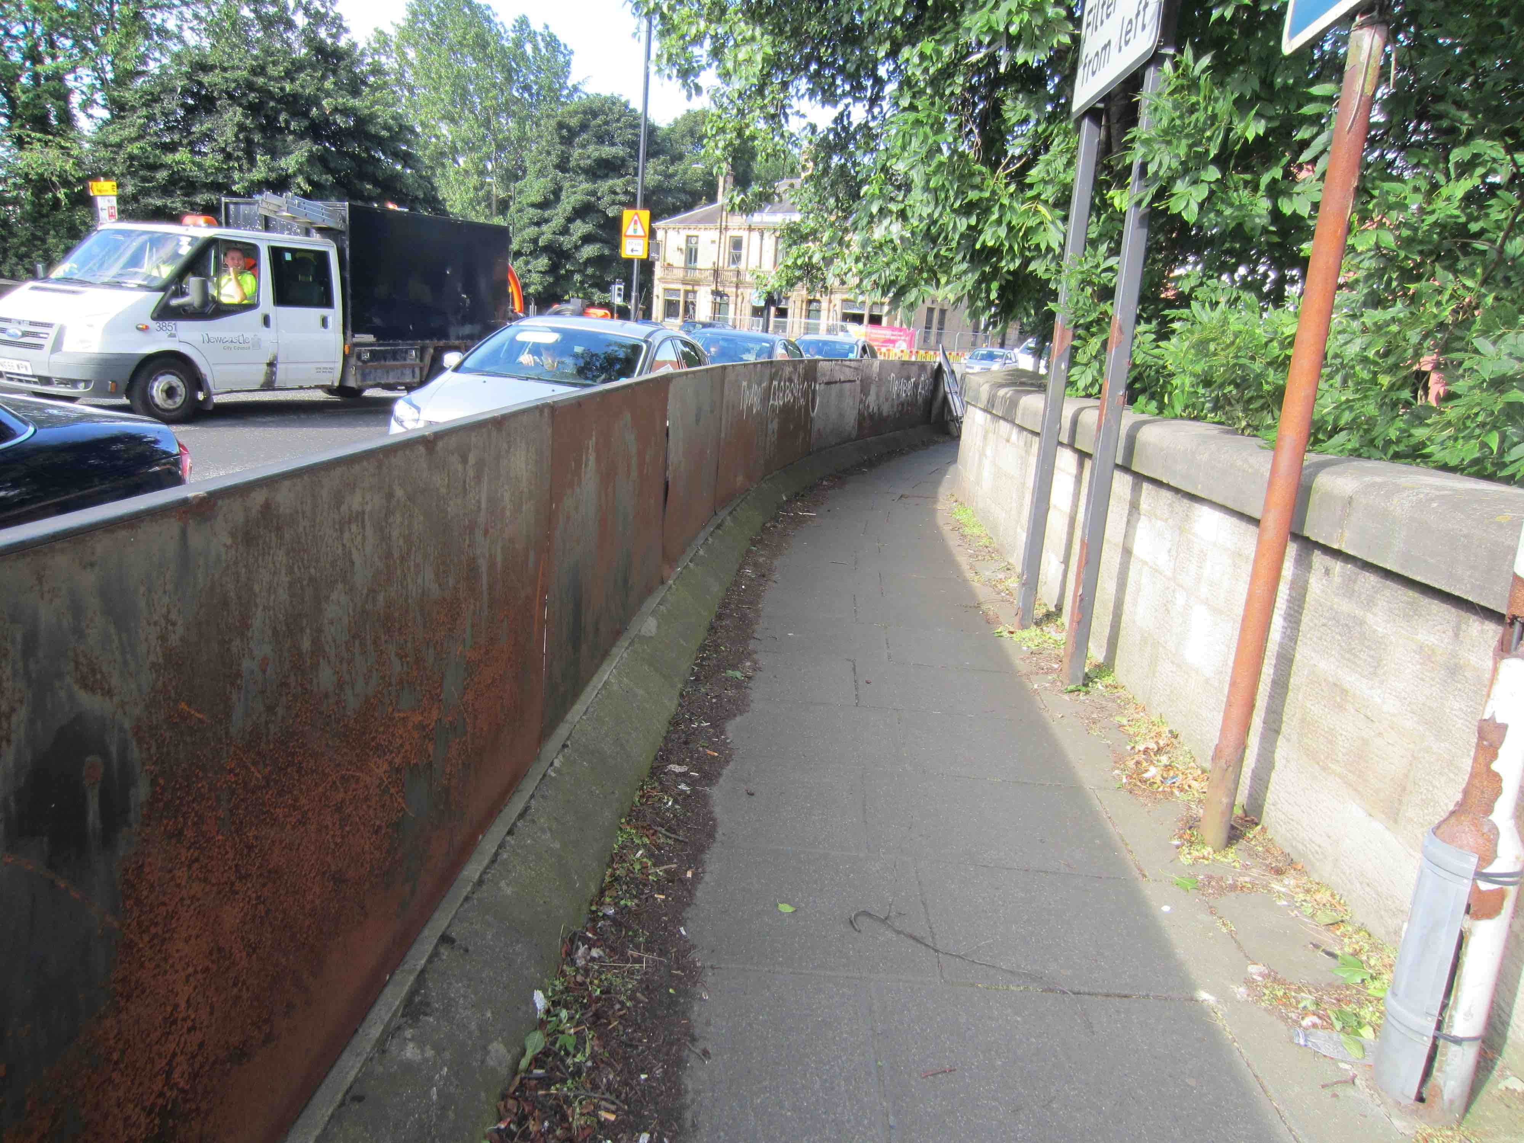
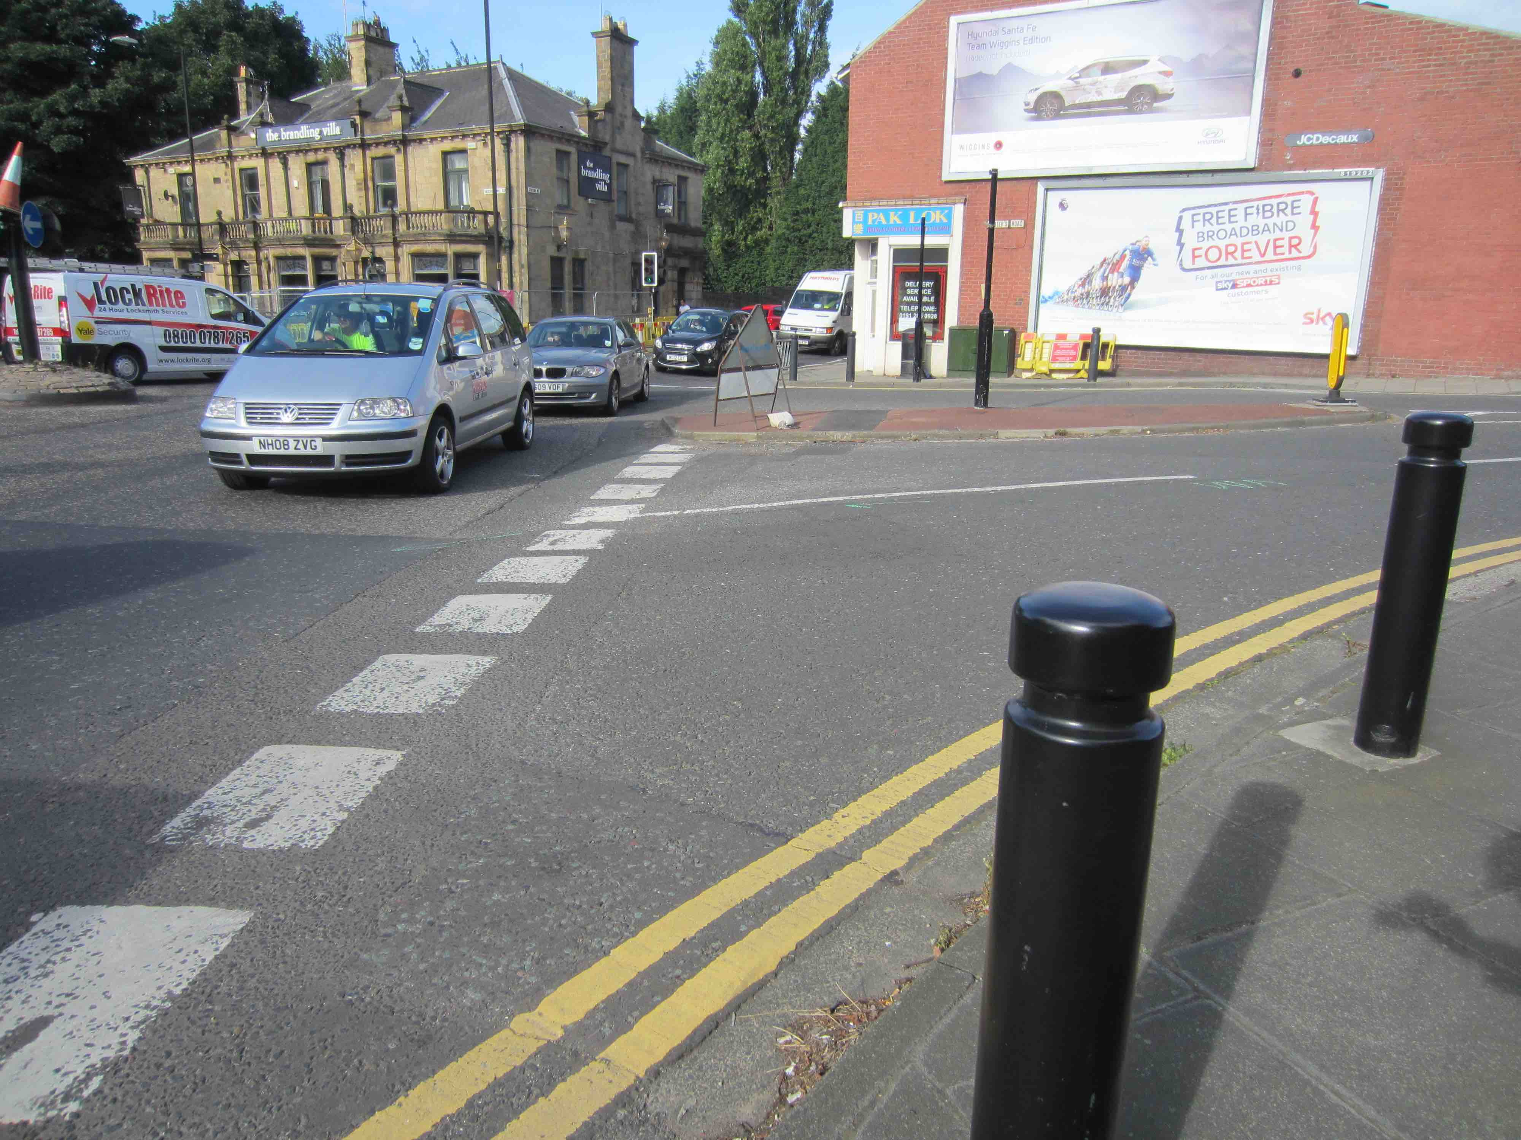
www.spaceforgosforth.com www.facebook.com/groups/space.gosforth/ www.twitter.com/space4gosforth

Slide 15
Haddricks Mill
Junction
(Apart from Killingworth Road) No onward cycle connections
Slow multi-stage pedestrian / cycle crossings
Loss of green space
Shared Space
Part of the AQMA
Filter lanes: non-standard design
Vehicles can enter roundabout without slowing
Poorly designed pedestrian & cycle facilities don’t get used as intended.
www.spaceforgosforth.com www.facebook.com/groups/space.gosforth/ www.twitter.com/space4gosforth

Slide 16
Poorly designed pedestrian & cycle facilities don’t get used as intended.
…and if those facilities aren’t being used as intended then the design probably isn’t right.
https://www.createful.com/2016/about-that-design-vs-user-experience-image/
www.spaceforgosforth.com www.facebook.com/groups/space.gosforth/ www.twitter.com/space4gosforth

Slide 17
Dutch safe design for a high-throughput roundabout
(up to 500-1500 motor vehicles per hour on the busiest arm of the roundabout)
>1500 motor vehicles => traffic lights or grade separation
Drivers are kept safe because the design reduces vehicle speeds through the roundabout
People walking and cycling are kept safe by having separate routes, both separate from vehicle traffic and part of a wider route network
Nobellaan, Assen, Netherlands
http://www.aviewfromthecyclepath.com/2014/05/the-best-roundabout-design-for-cyclists.html
www.spaceforgosforth.com www.facebook.com/groups/space.gosforth/ www.twitter.com/space4gosforth

Slide 18
Approximate size of proposed roundabout
www.spaceforgosforth.com www.facebook.com/groups/space.gosforth/ www.twitter.com/space4gosforth

Slide 19
Existing pavement retained for pedestrians /no shared space
Traffic lights as per the Council proposal
Traffic
Lights
A smaller roundabout means more retained green space
One east-bound lane over the Ouseburn but same queue capacity as the entrance to the roundabout is further east
Entries and exits to roundabout tighter to slow vehicles
More traditional roundabout design with no filter lanes
www.spaceforgosforth.com www.facebook.com/groups/space.gosforth/ www.twitter.com/space4gosforth

Slide 20
Traffic
Lights
www.spaceforgosforth.com www.facebook.com/groups/space.gosforth/ www.twitter.com/space4gosforth

Slide 21
Straight-over in one go
pedestrian/cycle
toucan crossings
Extra pavement & shorter road crossings
Traffic
Lights
Two-way protected cycle lanes link to The Waggonway, St Mary’s High School, The Ministry and Haddricks Mill Road
www.spaceforgosforth.com www.facebook.com/groups/space.gosforth/ www.twitter.com/space4gosforth

Slide 22
Bus lane
Traffic
Lights
Bus lane merges with other-vehicle lane, controlled by lights triggered when a bus arrives
www.spaceforgosforth.com www.facebook.com/groups/space.gosforth/ www.twitter.com/space4gosforth

Slide 23
Traffic
Lights
Note: This is a conceptual design illustrating the changes we would like to see.
Any detail design / impact assessment would need to be completed by the Council.
www.spaceforgosforth.com www.facebook.com/groups/space.gosforth/ www.twitter.com/space4gosforth

Slide 24
Station Road
www.spaceforgosforth.com www.facebook.com/groups/space.gosforth/ www.twitter.com/space4gosforth

Slide 25
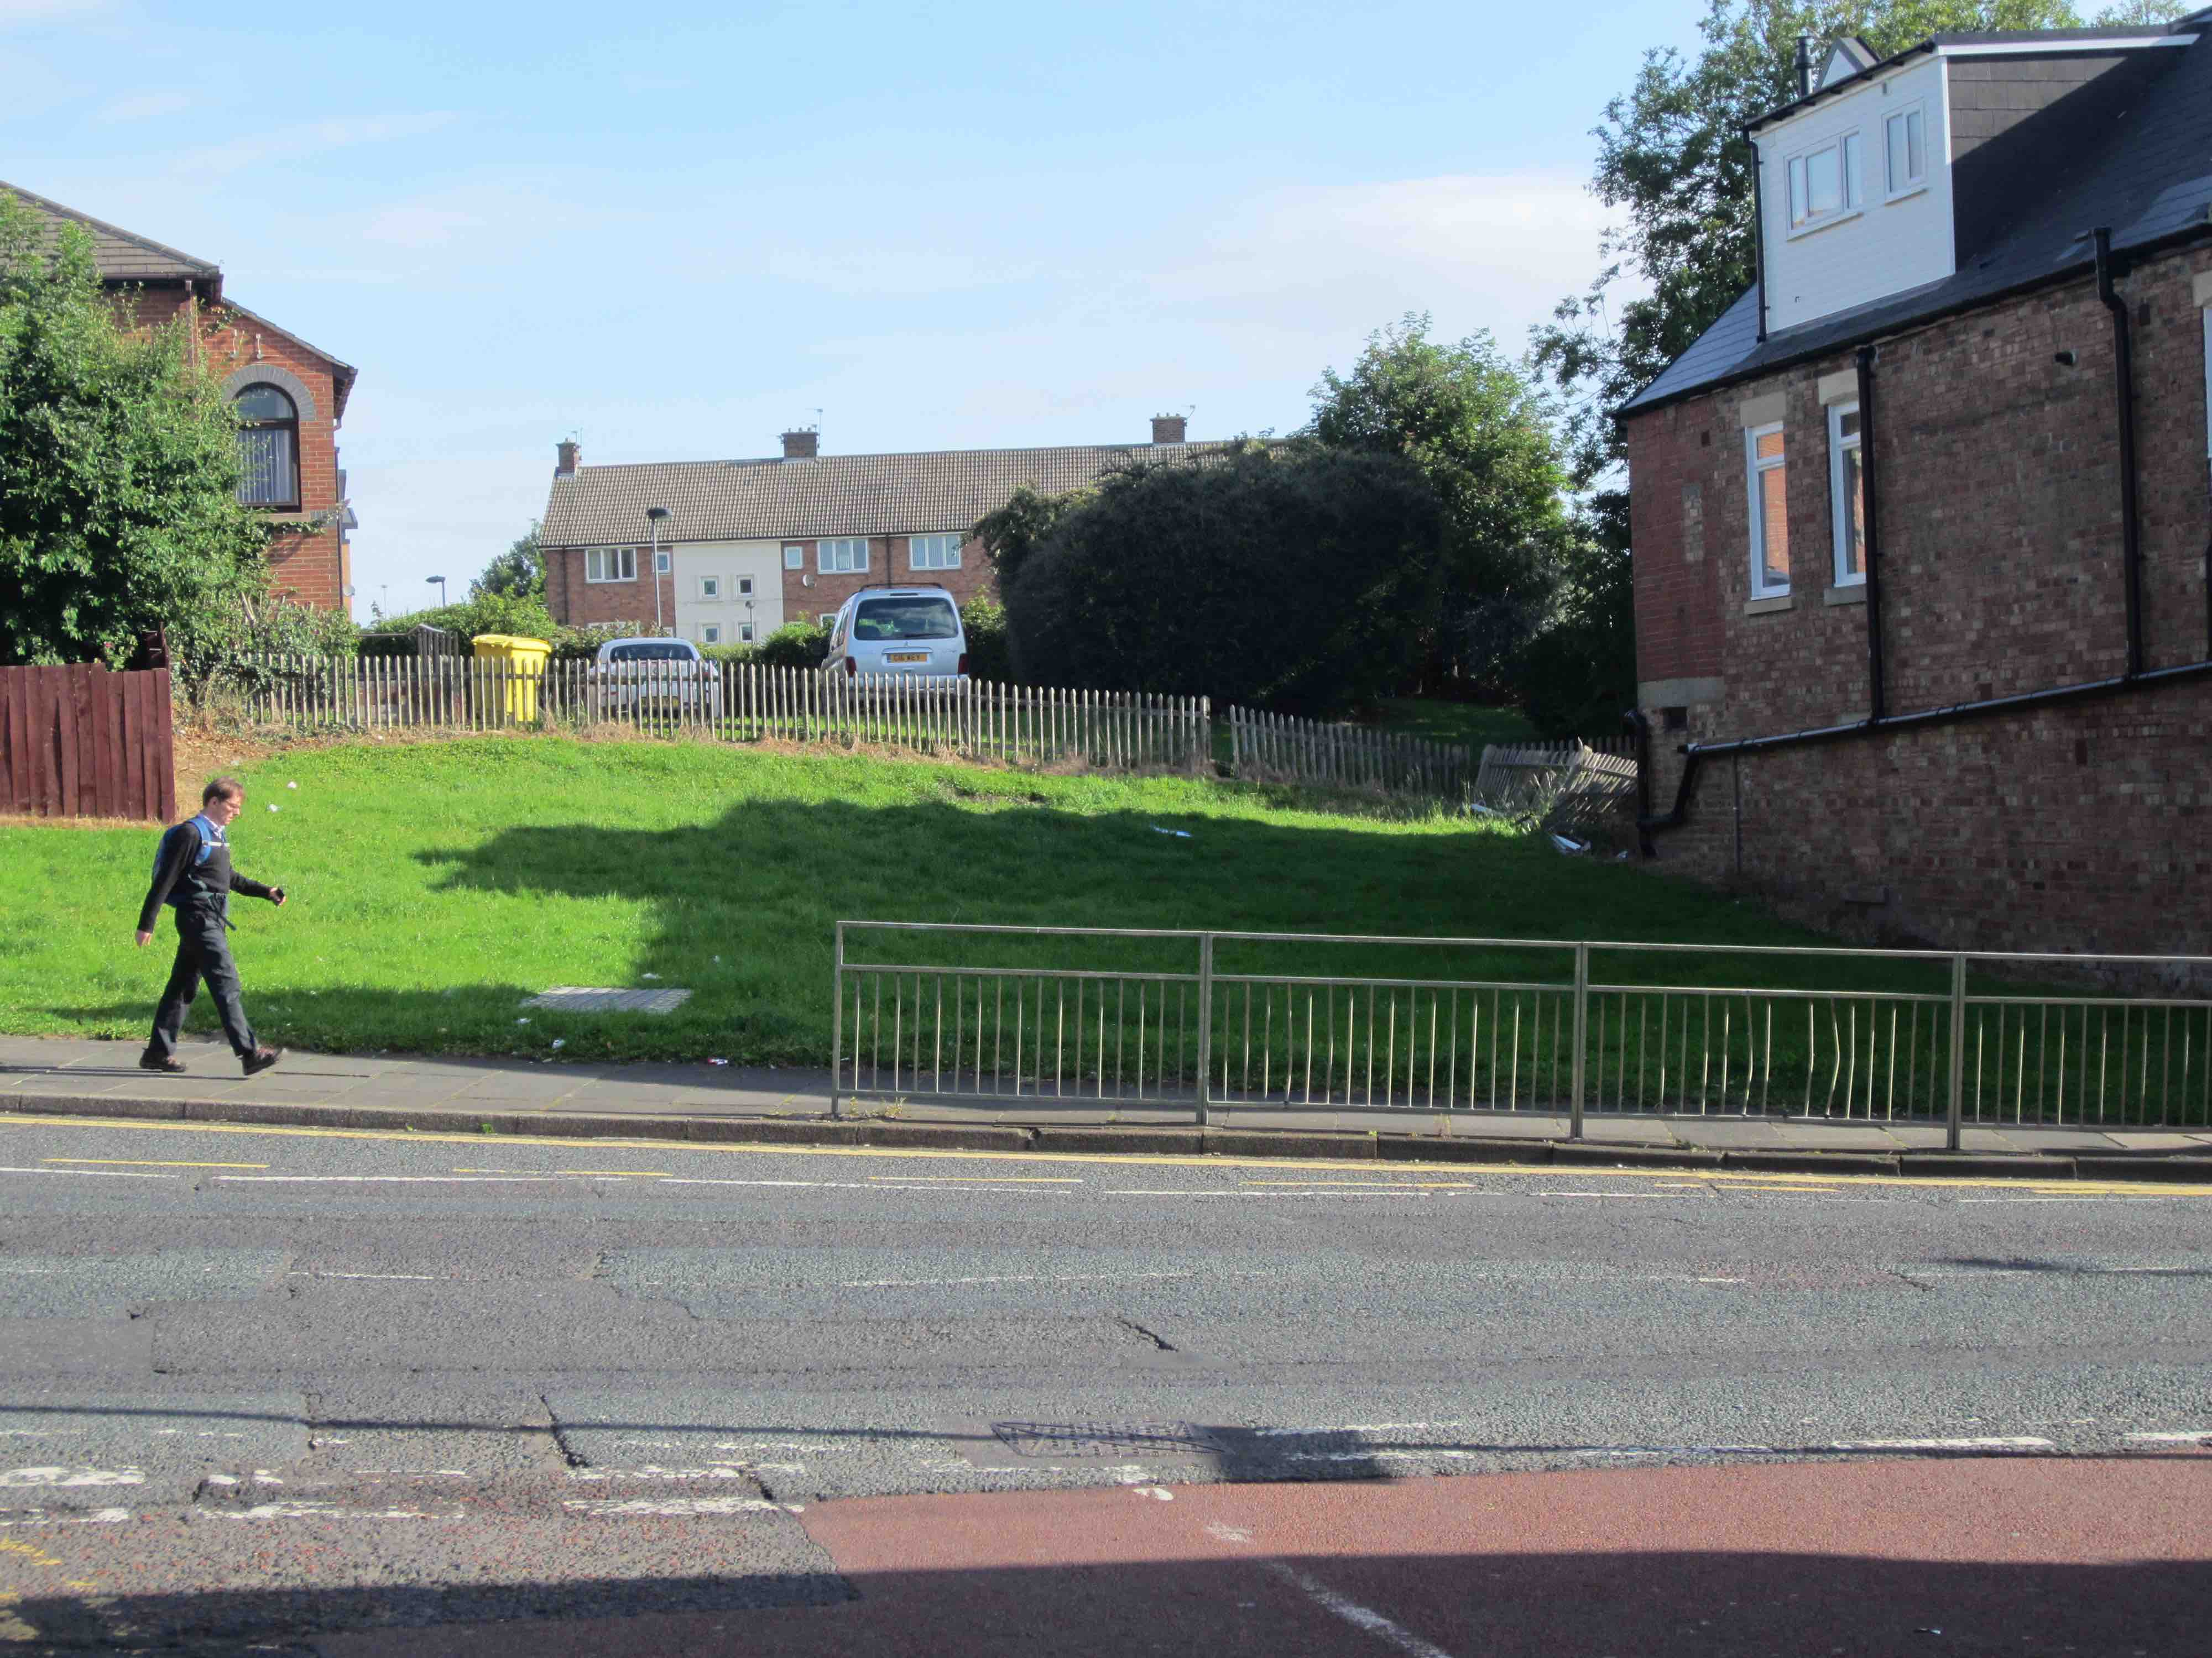
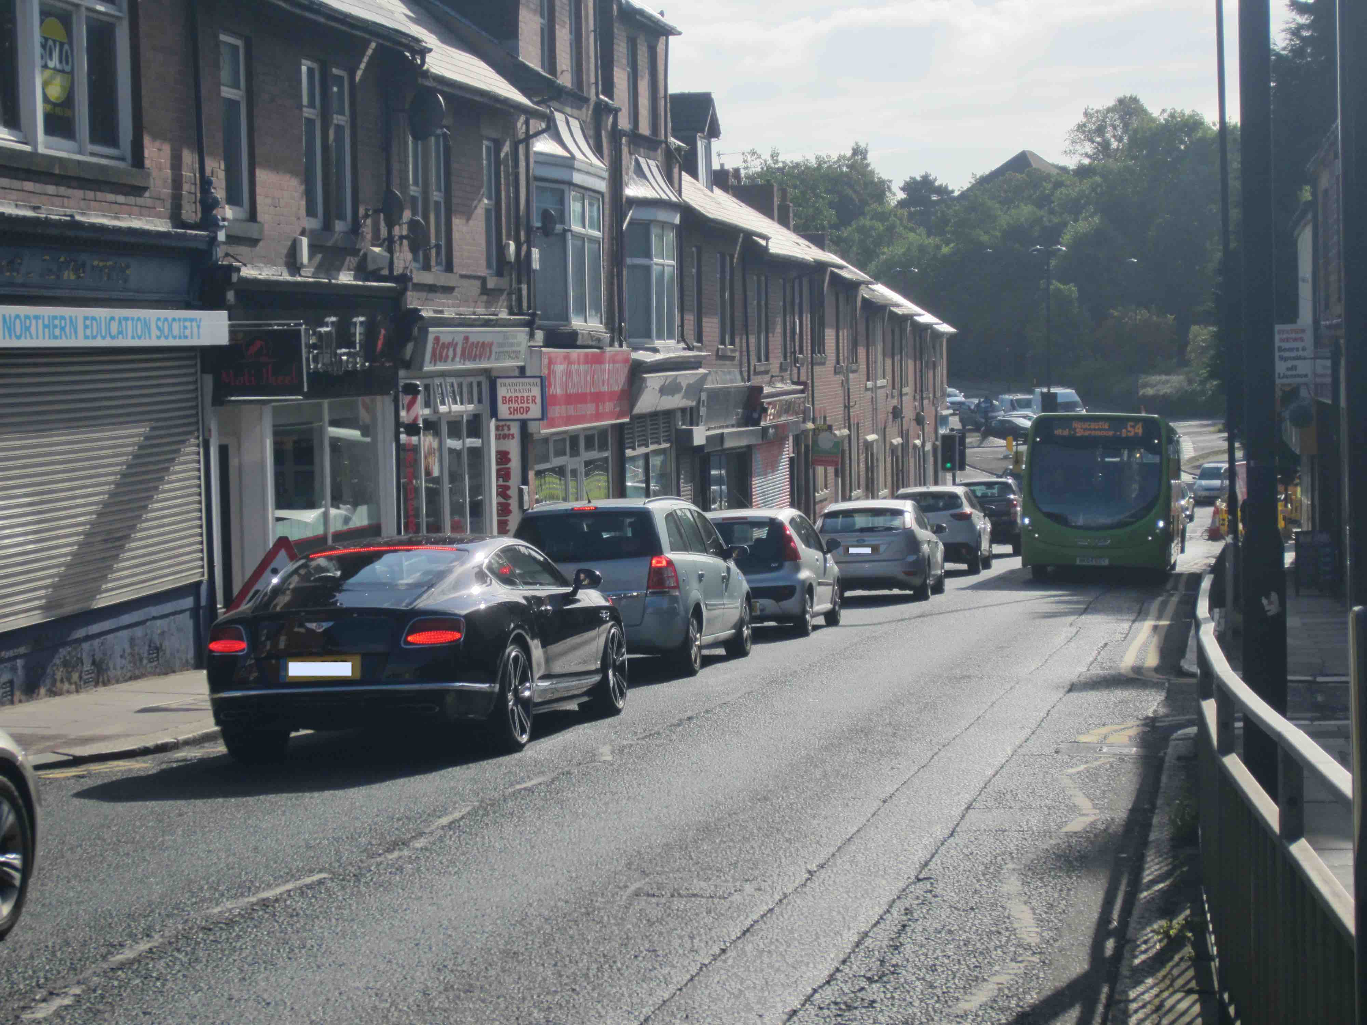
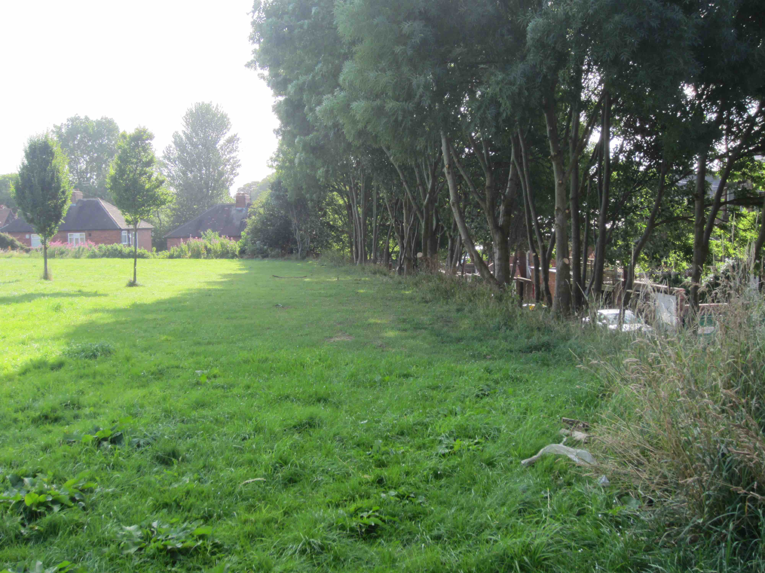
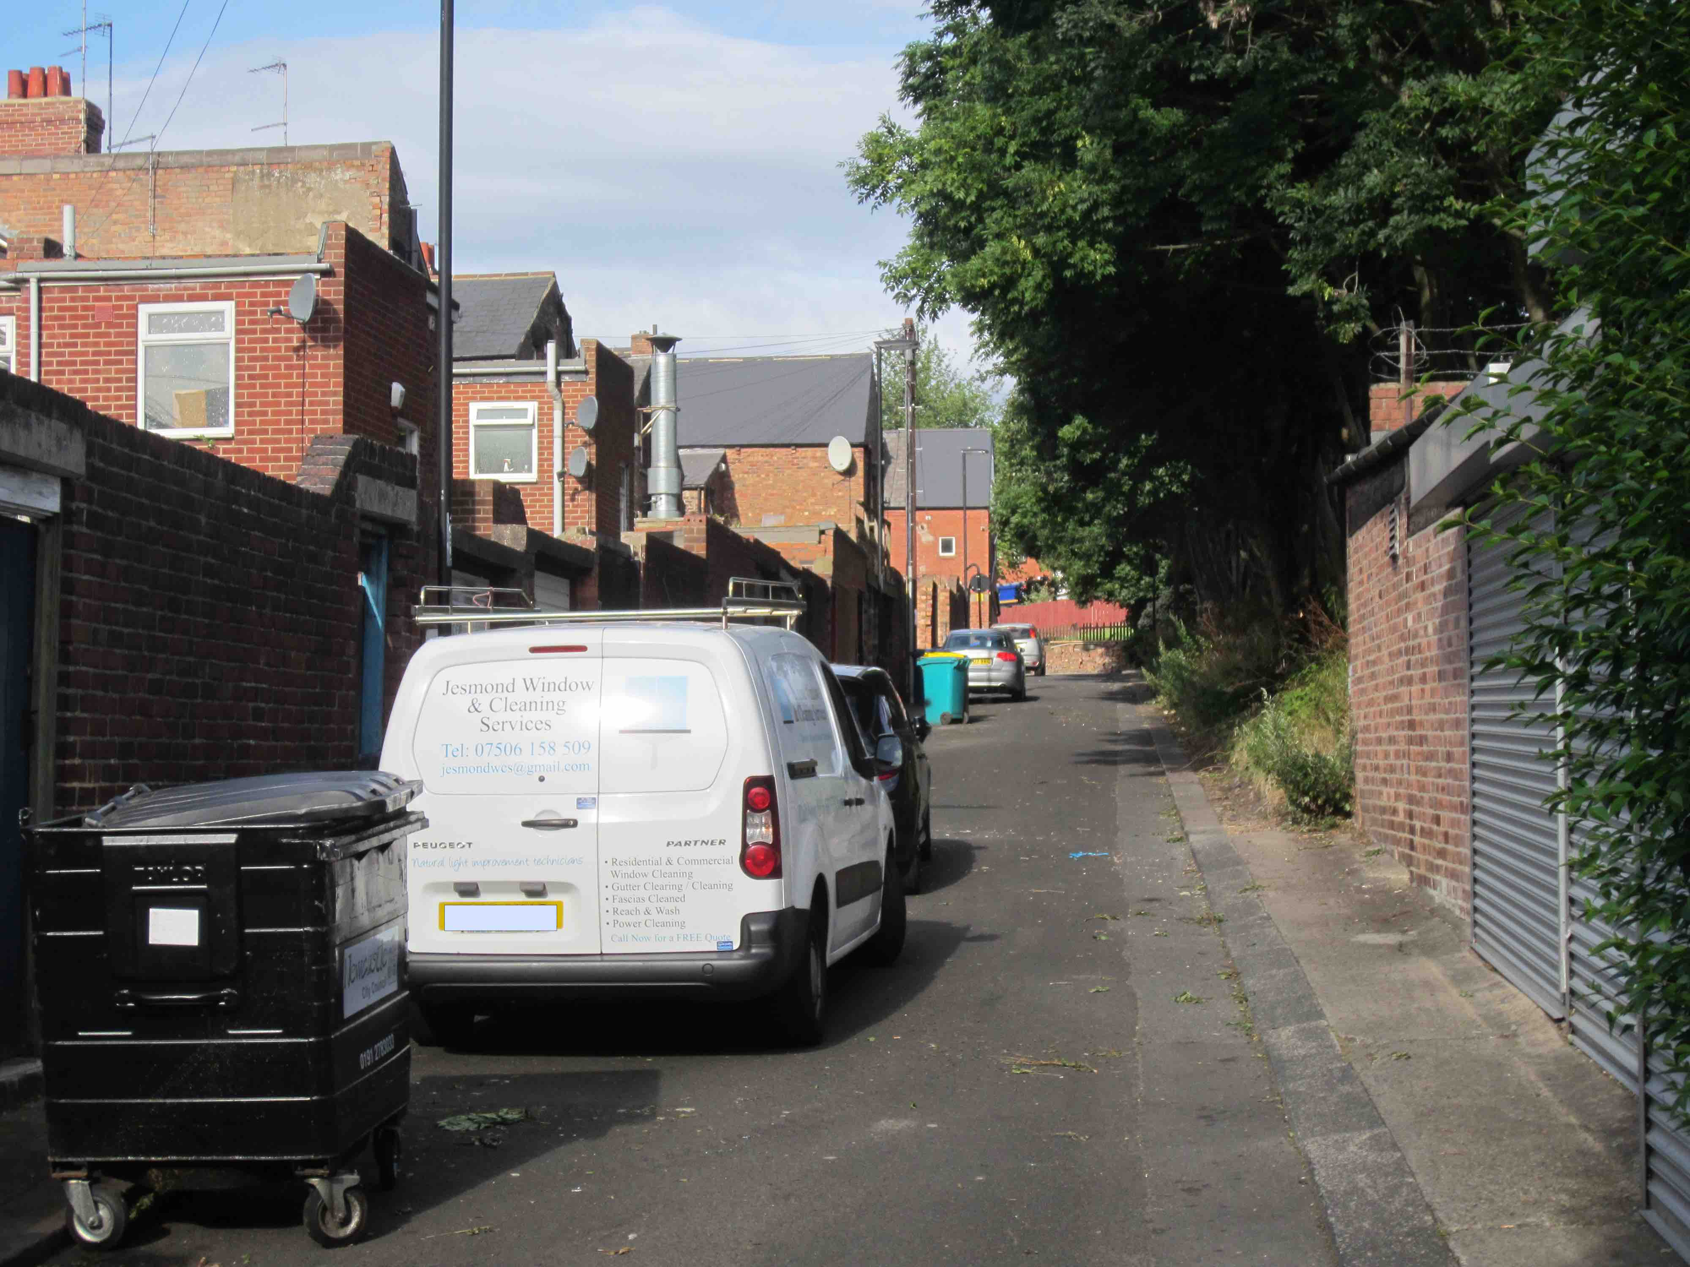
www.spaceforgosforth.com www.facebook.com/groups/space.gosforth/ www.twitter.com/space4gosforth

Slide 26
Station Road
Poor environment for walking / cycling
Cars might use the back lane to avoid traffic light queues?
Risk of crime?
Loss of Green Space
www.spaceforgosforth.com www.facebook.com/groups/space.gosforth/ www.twitter.com/space4gosforth

Slide 27
Station Road
Potential alternative
parking for shops
Two way shared alternative cycle/walking route behind the trees to avoid Station Road
More trees retained
Move pedestrian crossing west
to align with the shared path
New cycle parking
www.spaceforgosforth.com www.facebook.com/groups/space.gosforth/ www.twitter.com/space4gosforth

Slide 28
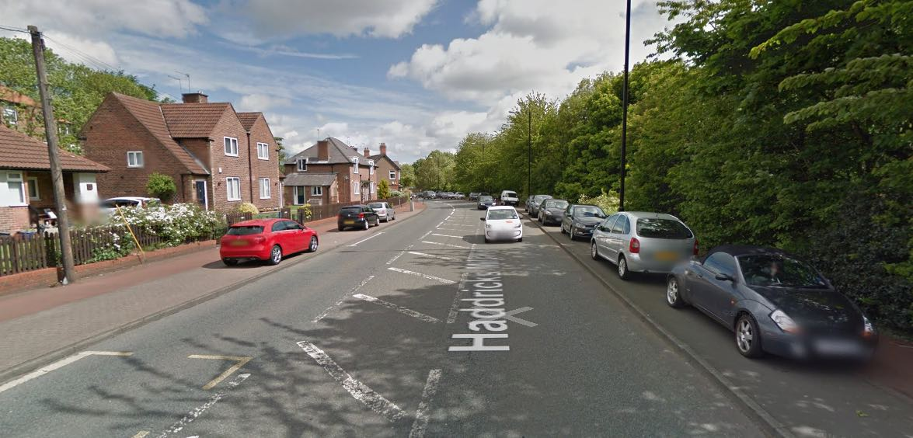
Haddricks Mill Road
Lack of usable pavement width
Wide lanes encourage speeding
Parking
Pavement
Proposal
North bound
lane
South bound
lane
Parking
Two way Cycle path
Wider
Pavement
www.spaceforgosforth.com www.facebook.com/groups/space.gosforth/ www.twitter.com/space4gosforth

Slide 29
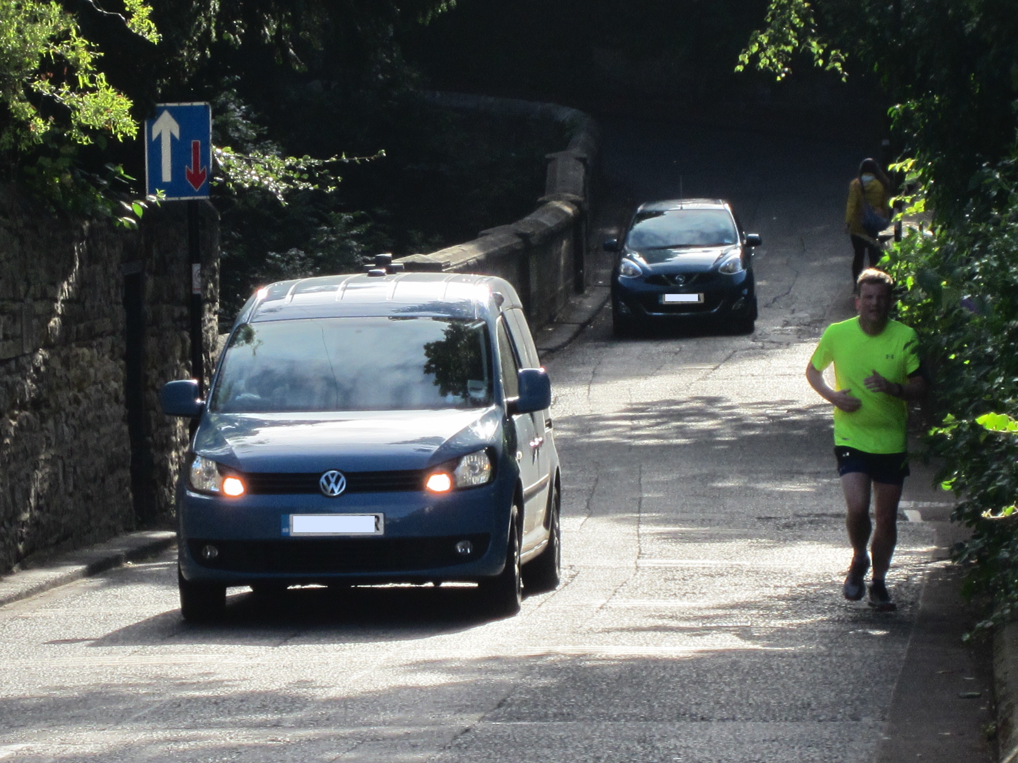
Castles Farm Road
www.spaceforgosforth.com www.facebook.com/groups/space.gosforth/ www.twitter.com/space4gosforth

Slide 30
Jesmond Dene Road
Existing Traffic Issues not addressed
No safe cycle routes
Poor linkage between Gosforth and Jesmond
www.spaceforgosforth.com www.facebook.com/groups/space.gosforth/ www.twitter.com/space4gosforth

Slide 31
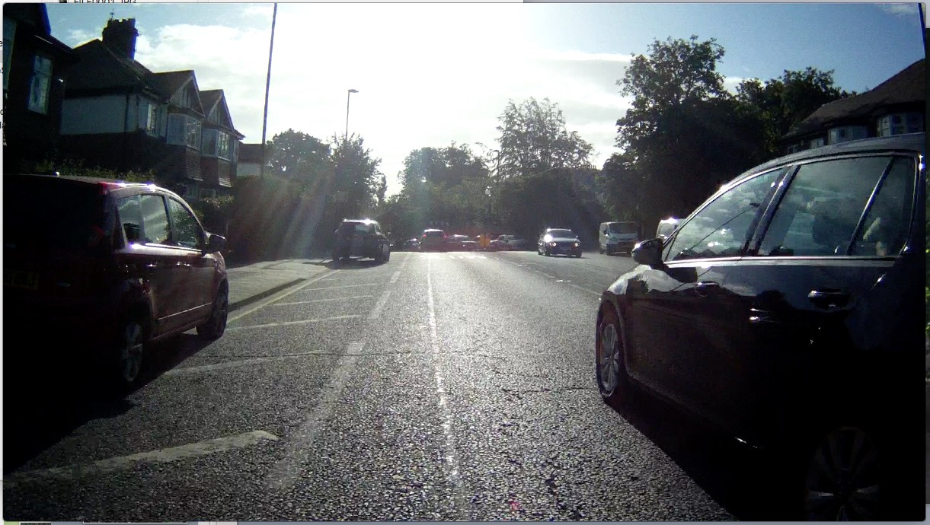
Jesmond Dene Road
There is space here for
2 traffic lanes, parking and cycle lanes
www.spaceforgosforth.com www.facebook.com/groups/space.gosforth/ www.twitter.com/space4gosforth

Slide 32
High West Jesmond
Idea: Reduce the volume of exiting traffic rather than banning turns
Two-way cycle track
separate from traffic
connects routes and
helps cycles to cross
Options for High West Jesmond
Leave as-is with traffic calming
www.spaceforgosforth.com www.facebook.com/groups/space.gosforth/ www.twitter.com/space4gosforth

Slide 33
High West Jesmond
Idea: Reduce the volume of exiting traffic rather than banning turns
Two-way cycle track
separate from traffic
Options for High West Jesmond
Leave as-is with traffic calming
Remove through traffic
www.spaceforgosforth.com www.facebook.com/groups/space.gosforth/ www.twitter.com/space4gosforth

Slide 34
High West Jesmond
Idea: Reduce the volume of exiting traffic rather than banning turns
Two-way cycle track
separate from traffic
Retain right turn option for buses.
Cars from H.W.J. can turn
right from Moorfield
Options for High West Jesmond
Leave as-is with traffic calming
Remove through traffic
Limit direct routes
www.spaceforgosforth.com www.facebook.com/groups/space.gosforth/ www.twitter.com/space4gosforth

Slide 35
Blue House
www.spaceforgosforth.com www.facebook.com/groups/space.gosforth/ www.twitter.com/space4gosforth

Slide 36
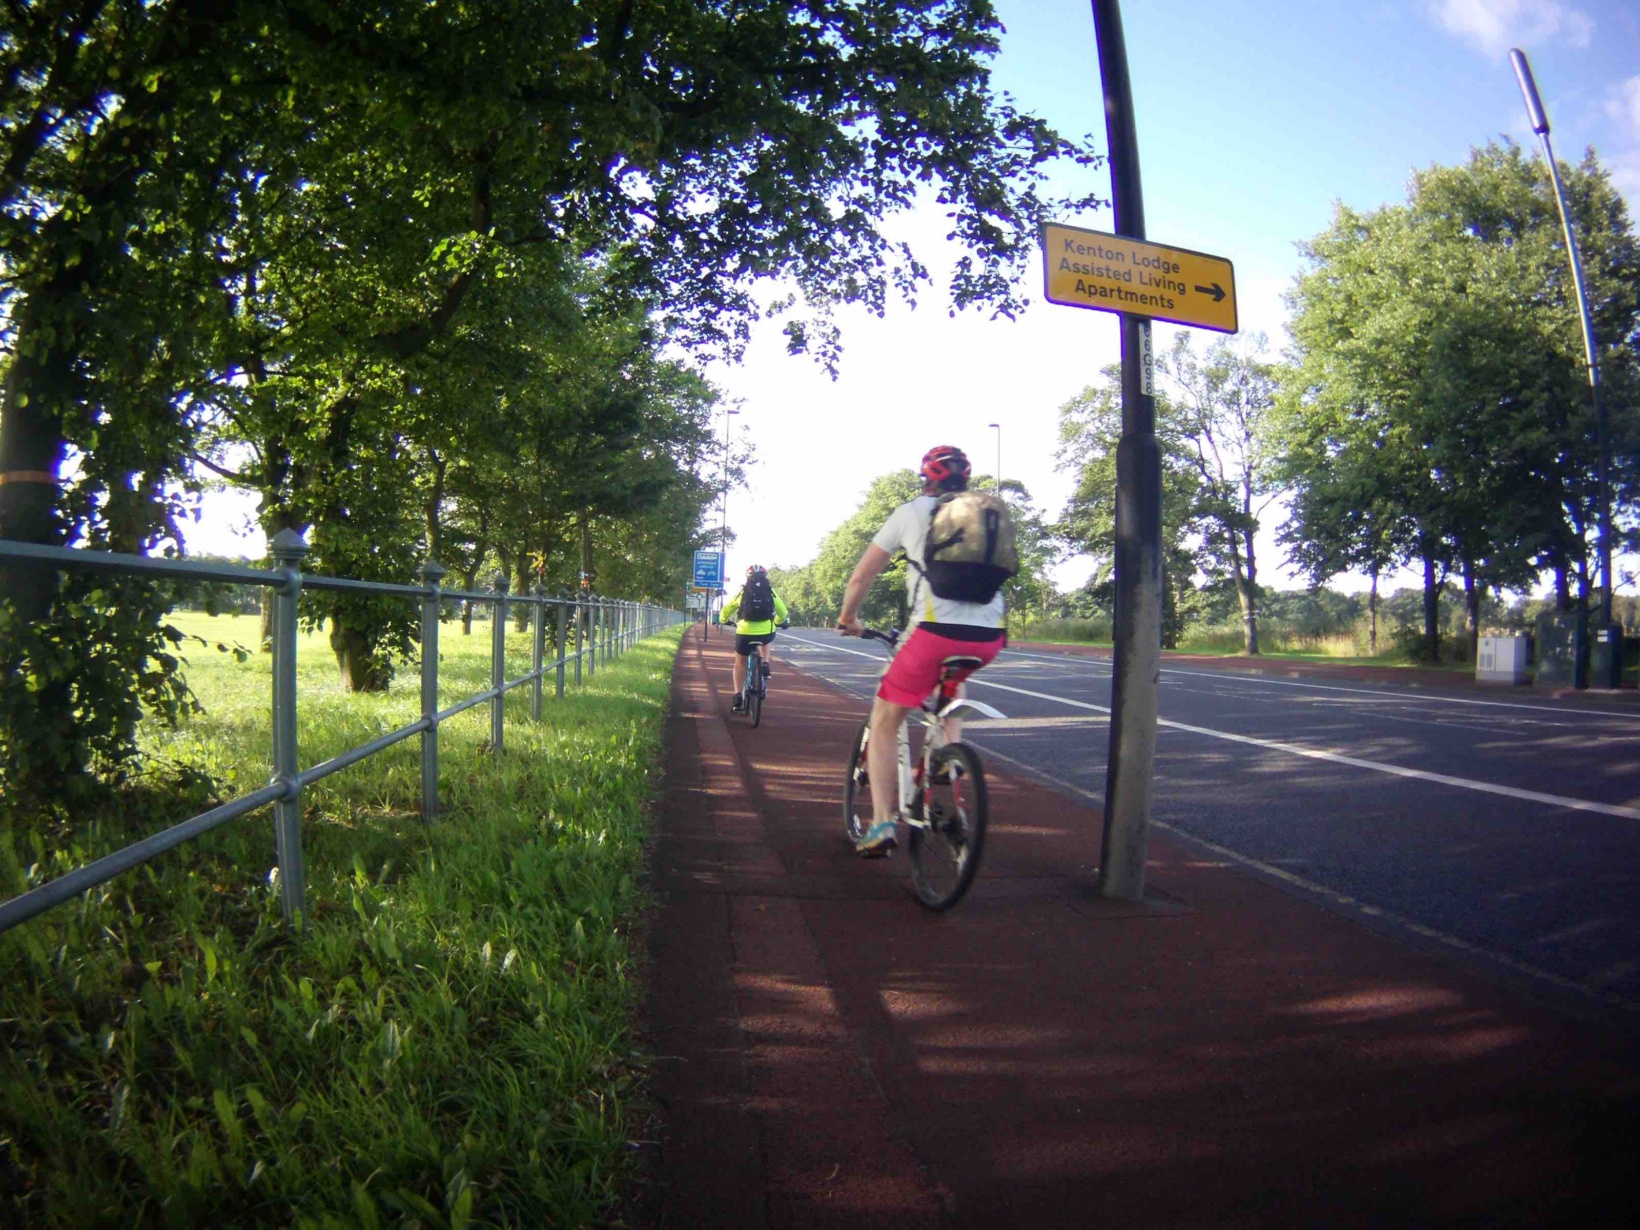
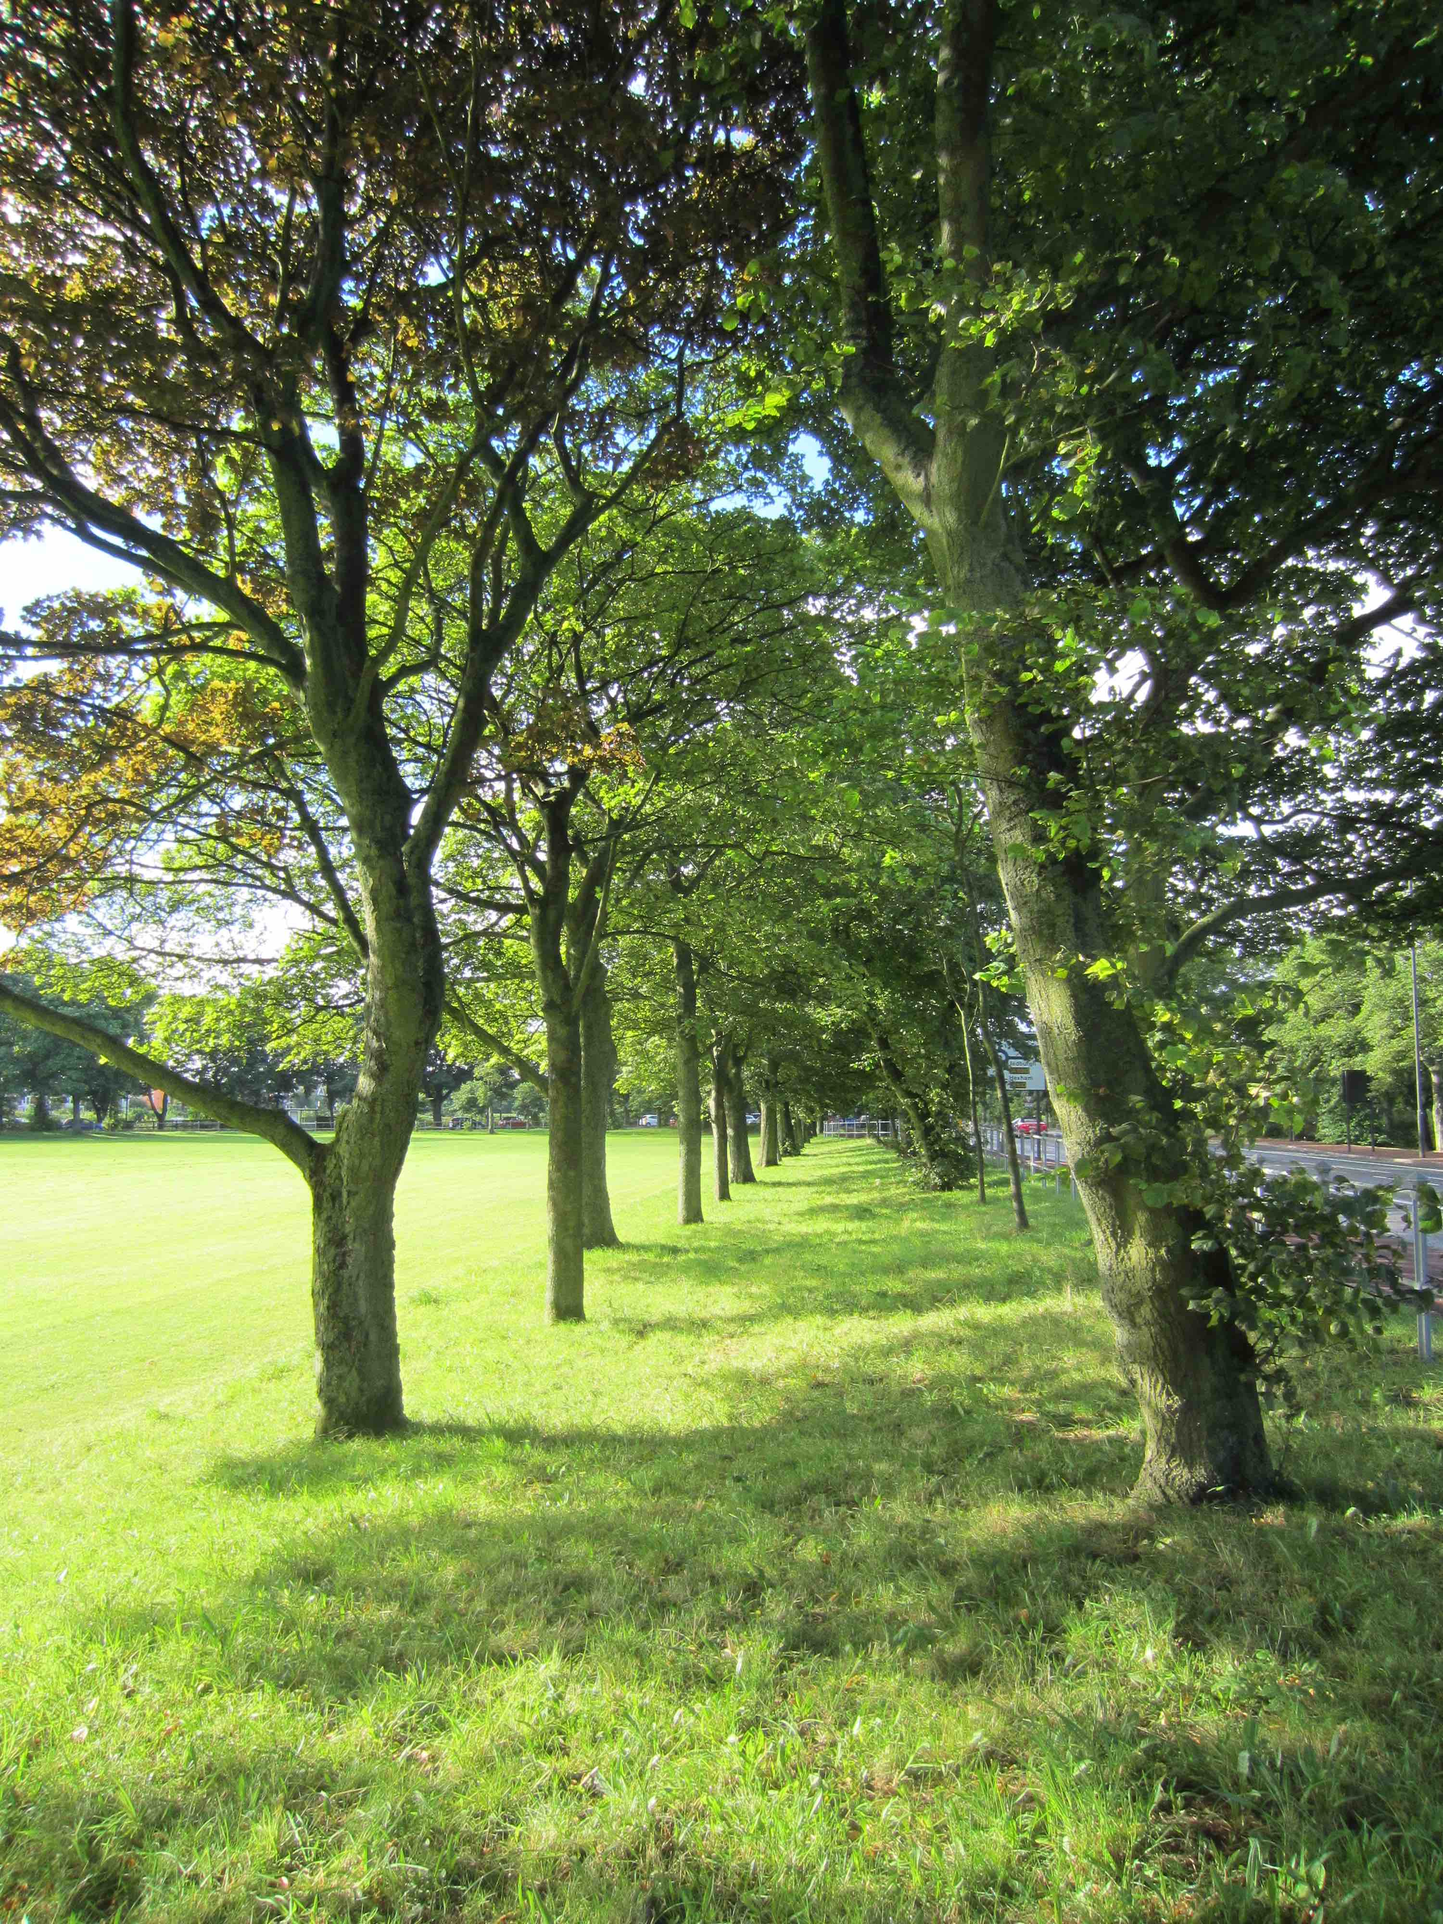
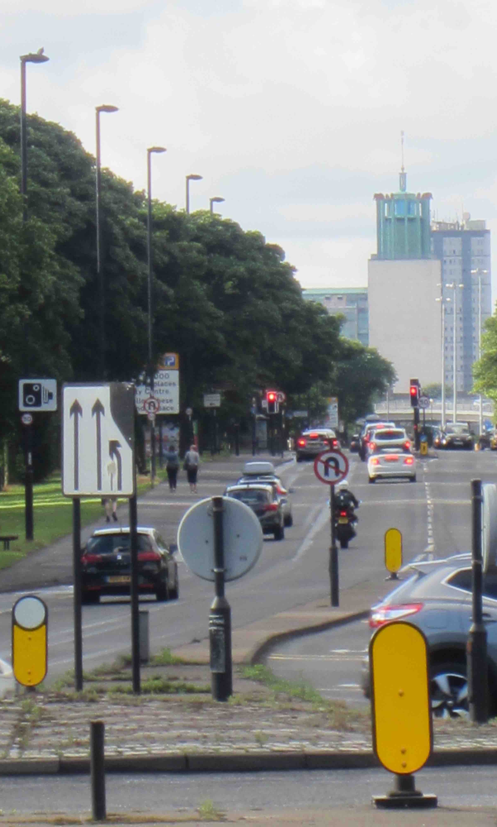
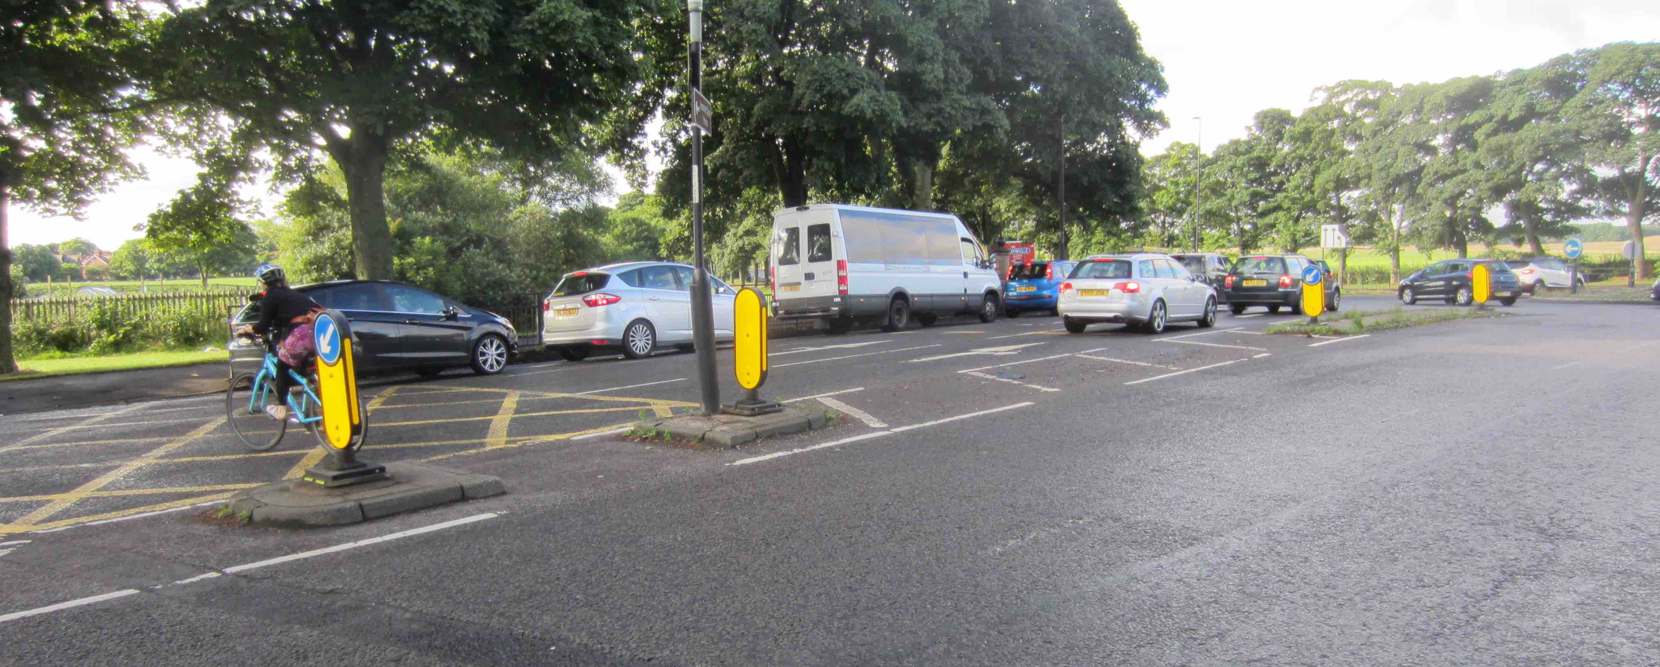
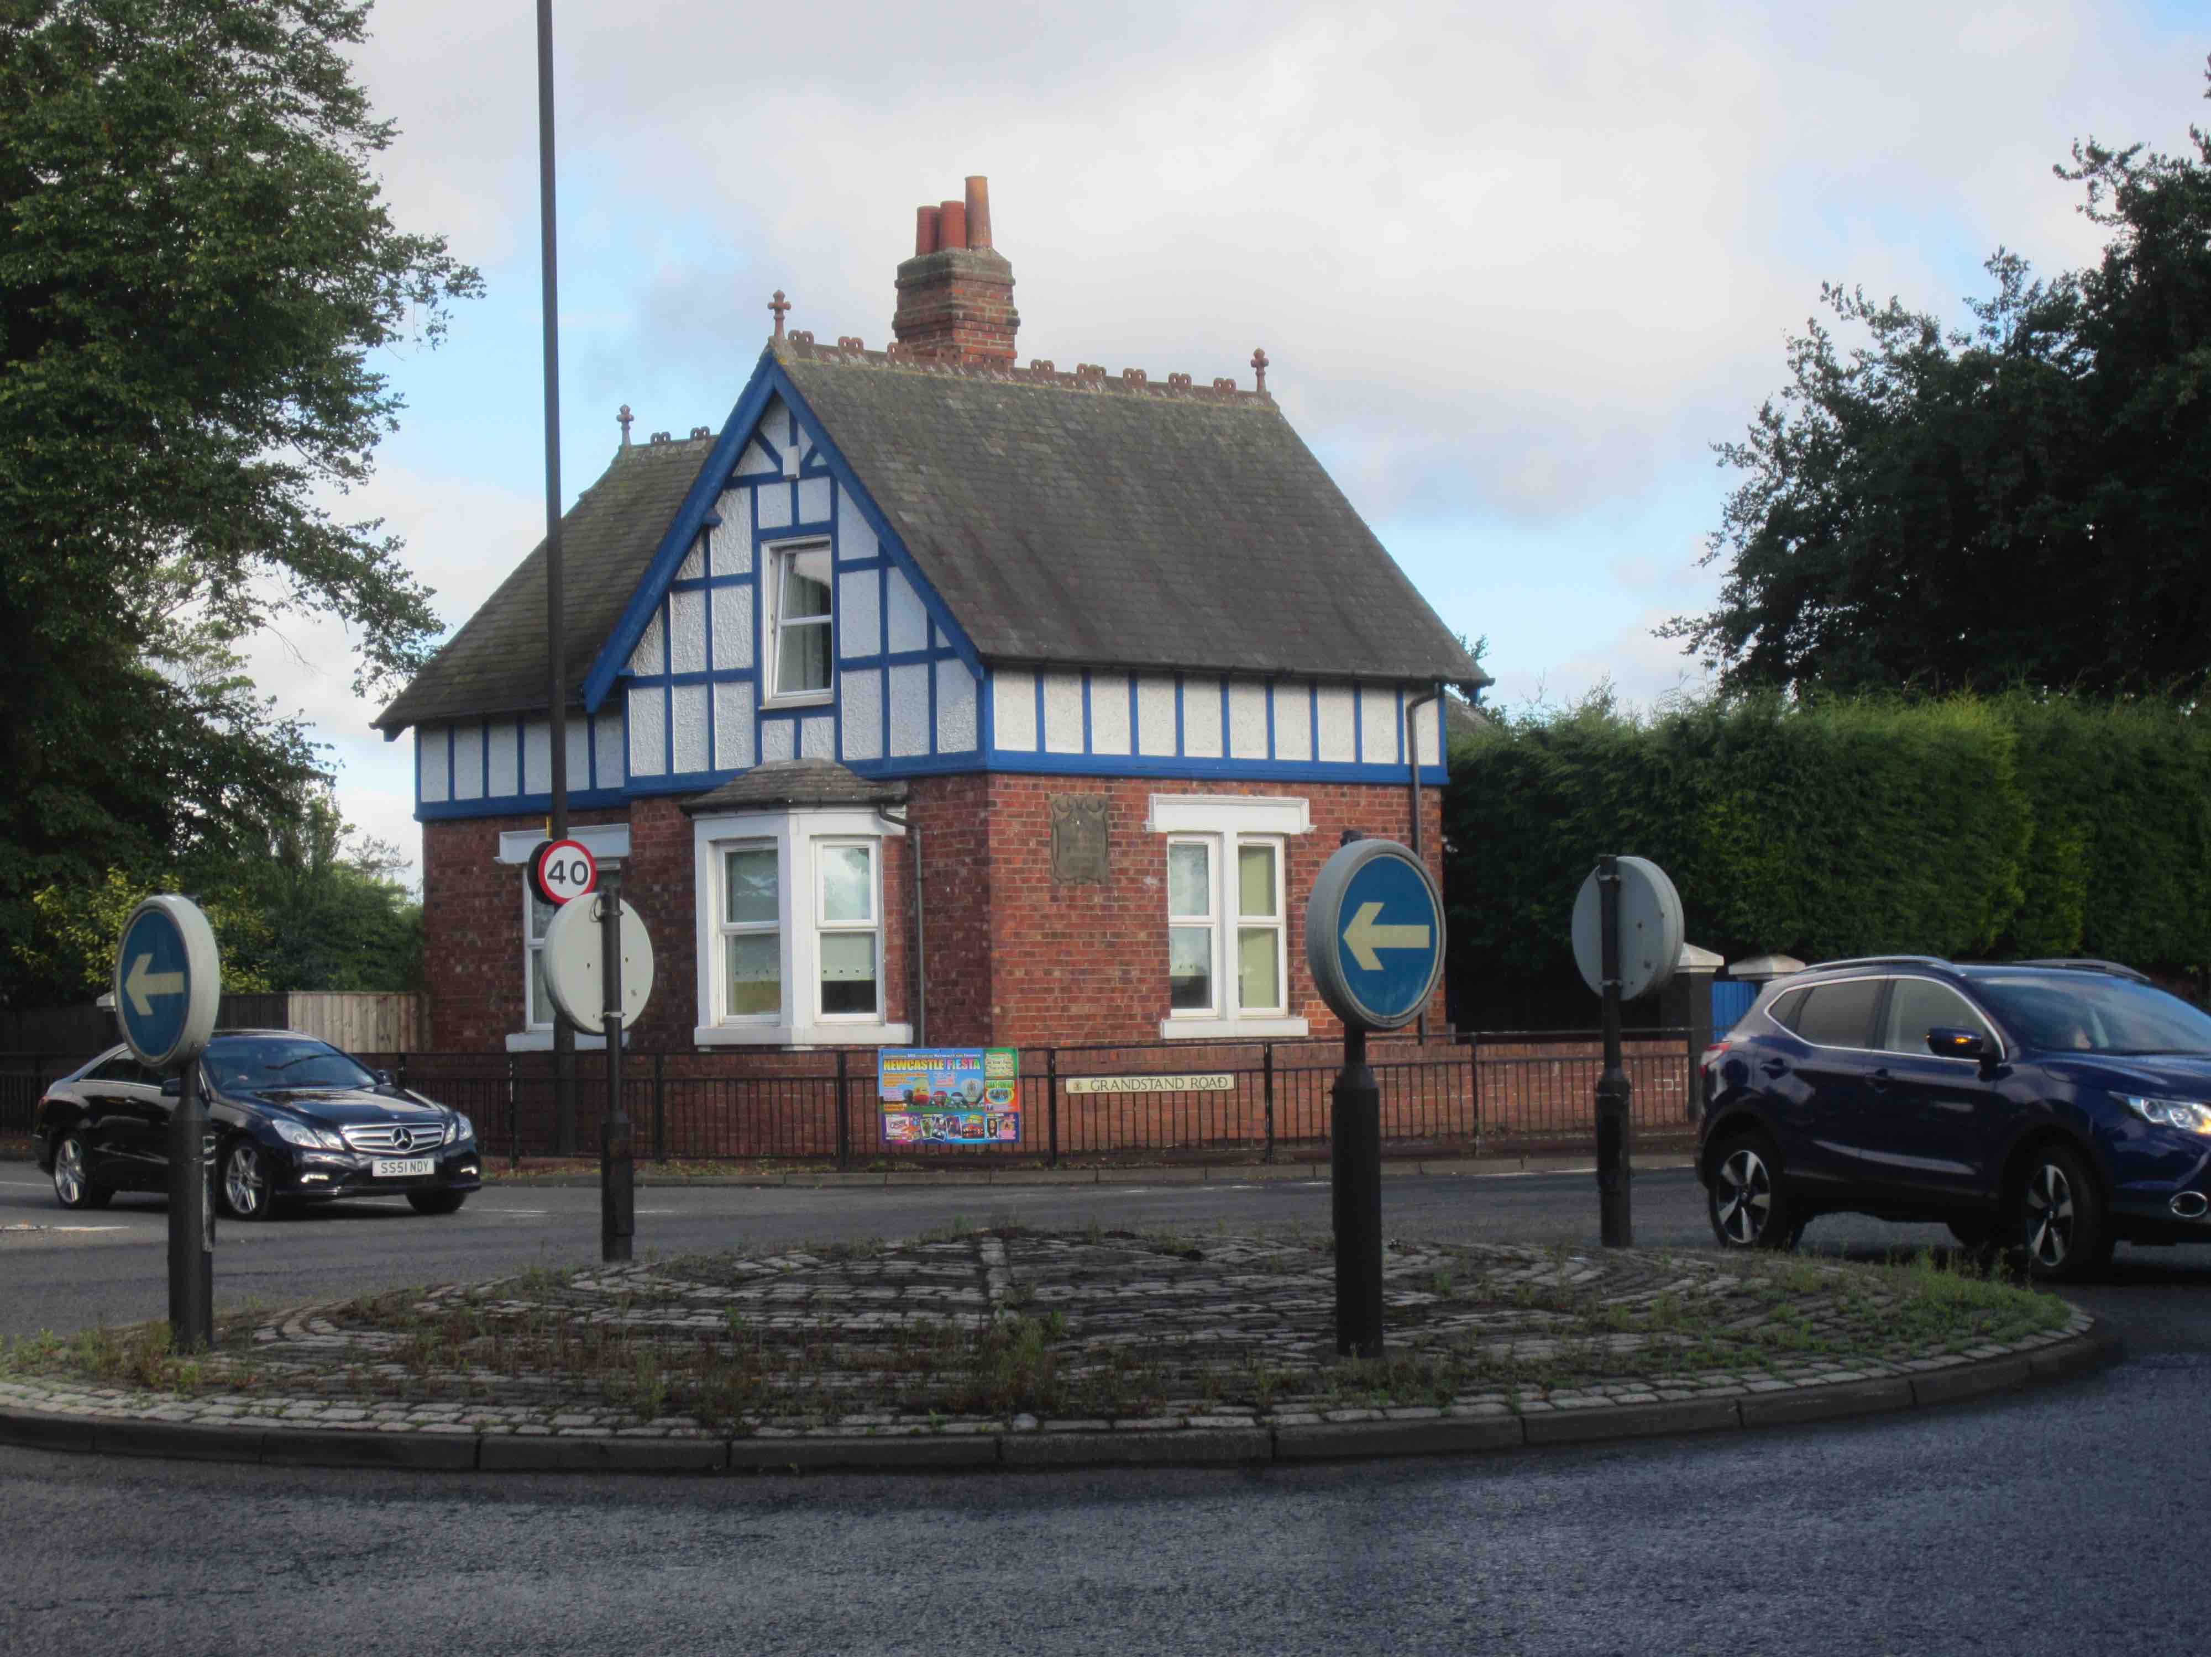
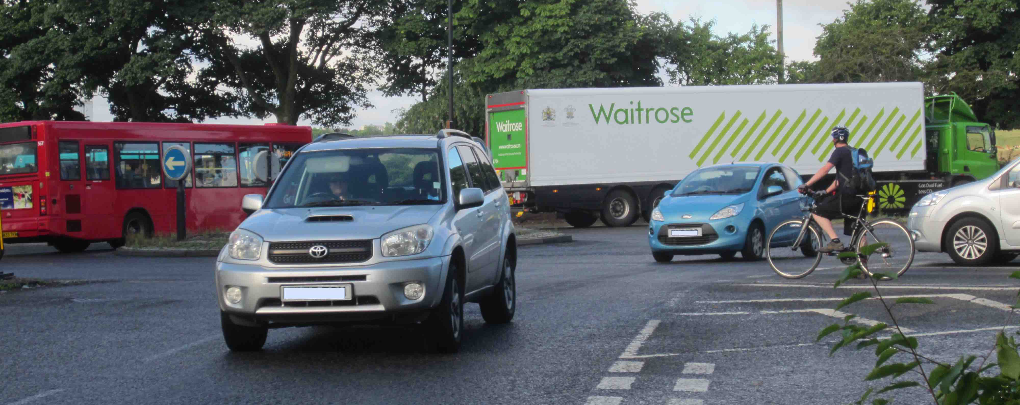
MOVEMENT
PLACE
WALK / CYCLE CROSSING
www.spaceforgosforth.com www.facebook.com/groups/space.gosforth/ www.twitter.com/space4gosforth

Slide 37
Blue House
It’s enormous!
Part of the AQMA
It’s the Town Moor!part of what makes Newcastle special
Multi multi-stage crossings
Induced Traffic –
Air Quality
www.spaceforgosforth.com www.facebook.com/groups/space.gosforth/ www.twitter.com/space4gosforth

Slide 38
WALK/
CYCLE
Walking/cycling routes as for a high volume ‘Dutch’ junction
BUS
CAR
R
Added bus priority
Traffic lights to be used selectively to control throughput of the dominant arms.
Capacity has been added through walking, cycling and bus travel so extra vehicle capacity is not required.
R
Traffic lights to prioritise bus right turns. Buses approach in left lane
www.spaceforgosforth.com www.facebook.com/groups/space.gosforth/ www.twitter.com/space4gosforth

Slide 39
Blue House to Haddricks Mill
The End
www.spaceforgosforth.com www.facebook.com/groups/space.gosforth/ www.twitter.com/space4gosforth

Slide 40
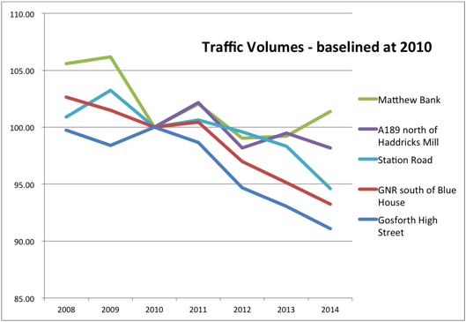
Recent Traffic Volumes
- The new junctions are based on a forecast of 20%+ growth in vehicle traffic
www.spaceforgosforth.com www.facebook.com/groups/space.gosforth/ www.twitter.com/space4gosforth

Slide 41
Blue House to Haddricks Mill
Proposed Changes
- Wider Impact
Employment Sites
Health Sites
Education Sites
Northern Access Corridor

Slide 42
Blue House to Haddricks Mill
Proposed Changes
+ 20% more vehicle traffic
Induced Traffic
Air Quality Management Areas

Slide 43
Blue House to Haddricks Mill
Proposed Changes
- alternative travel options
P
P
P
48 buses per hour each way (daytime)
P
P
P
P
P
3 miles from Blue House
~=15 minutes on a cycle
Metro
Park and Ride
P
P

